Slide 1
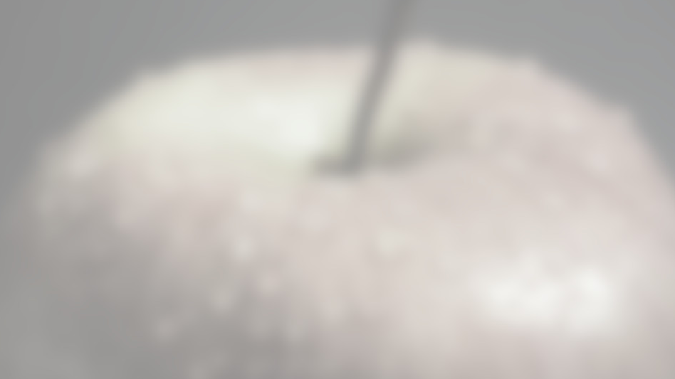



Everis Machine Learning Prize
João Figueira
Tiago Almeida

Slide 2
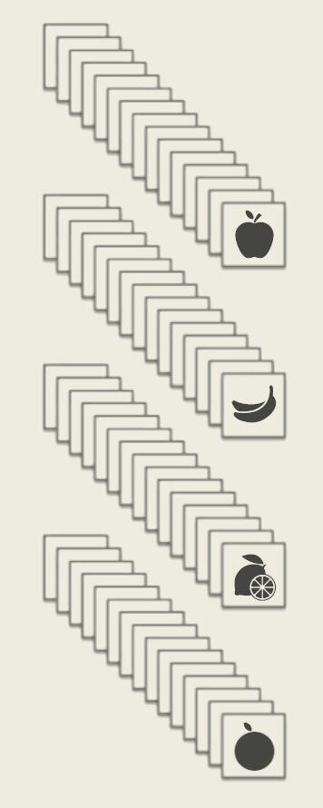
1st Phase Dataset Creation

Slide 3
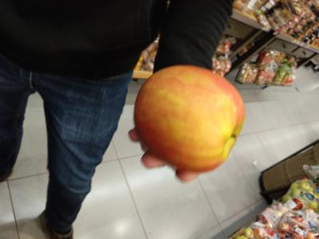
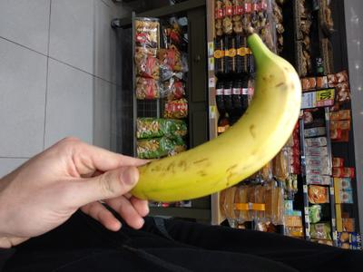
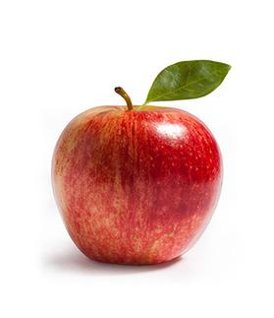
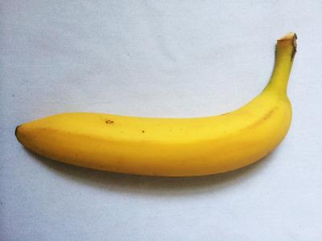
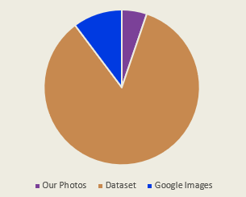
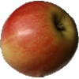
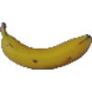
Dataset Sources
Using Google images scraping library for Python by Hardikvasa
Fruits 360 Dataset by M. Oltean
Notes:
880 our photos
14241 Horea
1962 google
=
17083 total
Data augmentation → flipping, rotation and some color correction

Slide 4
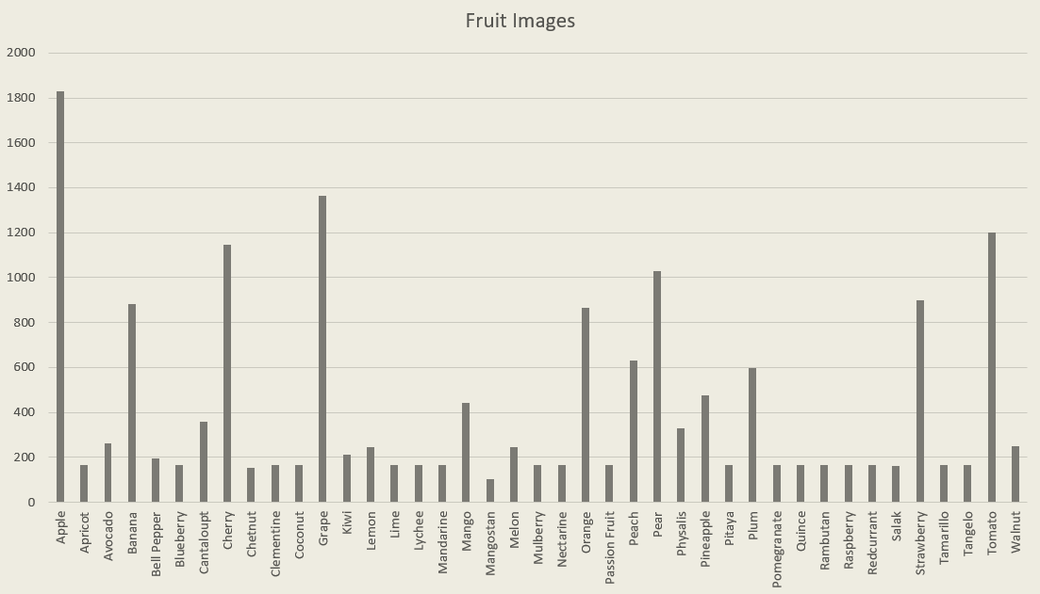
Dataset Composition

Slide 5
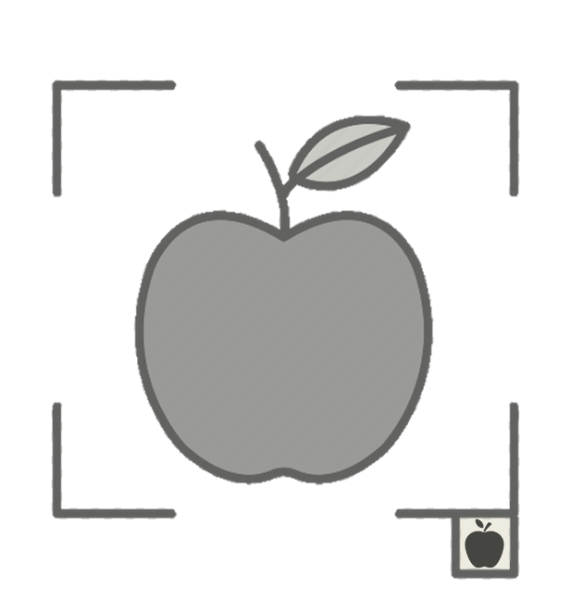
2nd Phase Single Fruit Classification

Slide 6
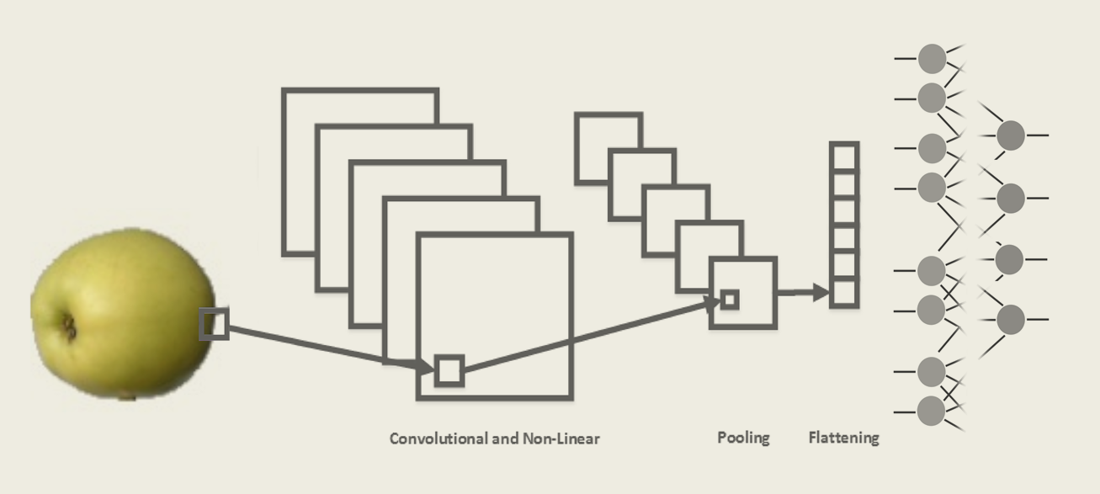
Convolutional Neural Network
Notes:
2*convolution 5x5 window relu
2*convolution 5x5 window tanh
1*2D pooling
2*Dense

Slide 7
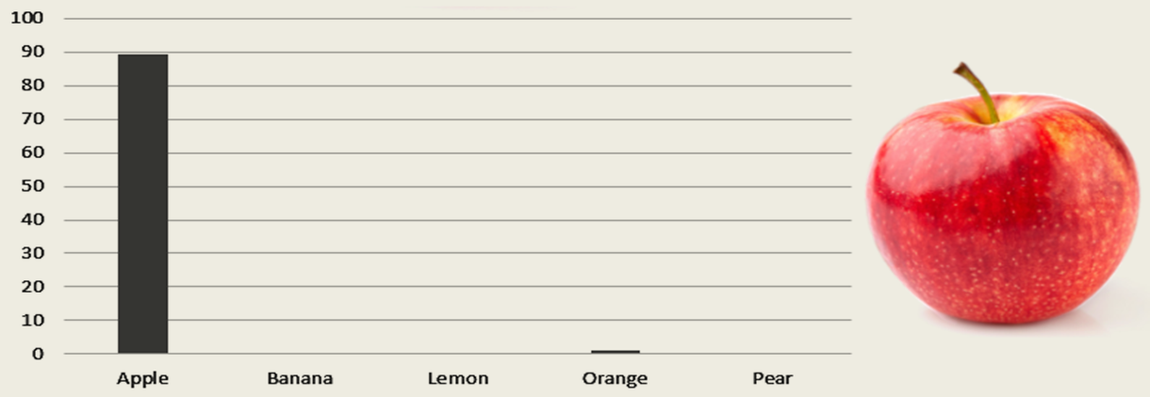
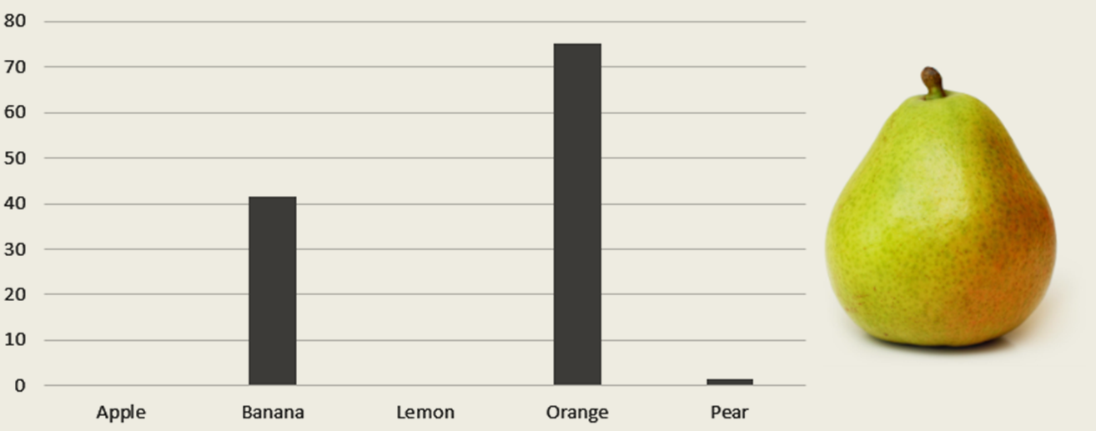

Slide 8
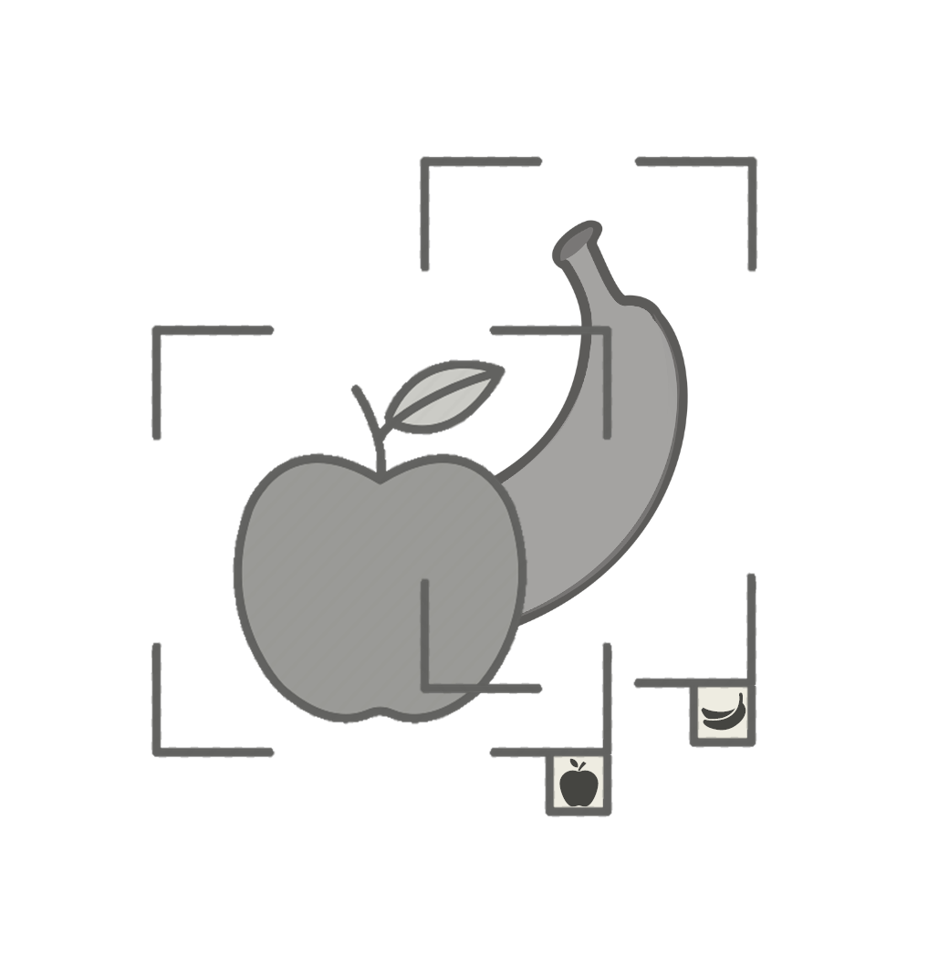
3rd Phase Multiple Fruit Detection

Slide 9
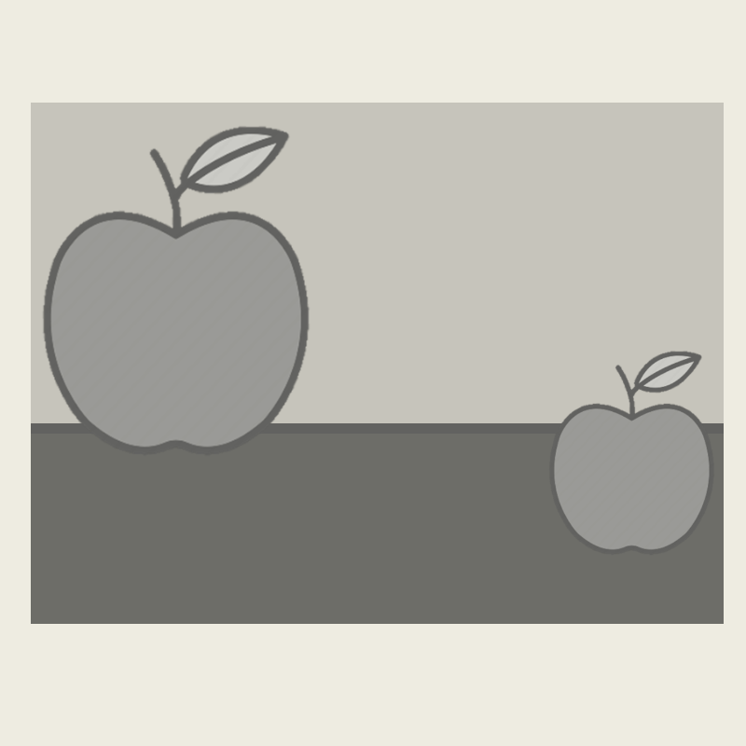
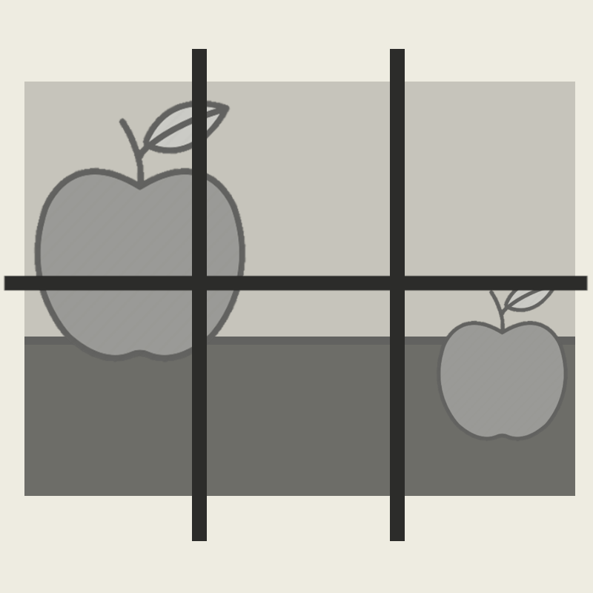
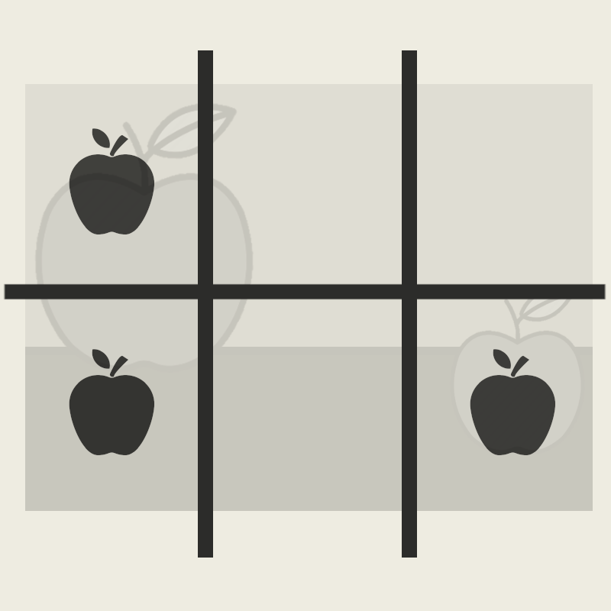
1st Approach Using 2nd Phase Model
Notes:
To use old model:
Split into equal size segments and classify each (use different sizes and select one that maximizes average certainty)
Almost always classifies as fruit → requires new class (other)

Slide 10
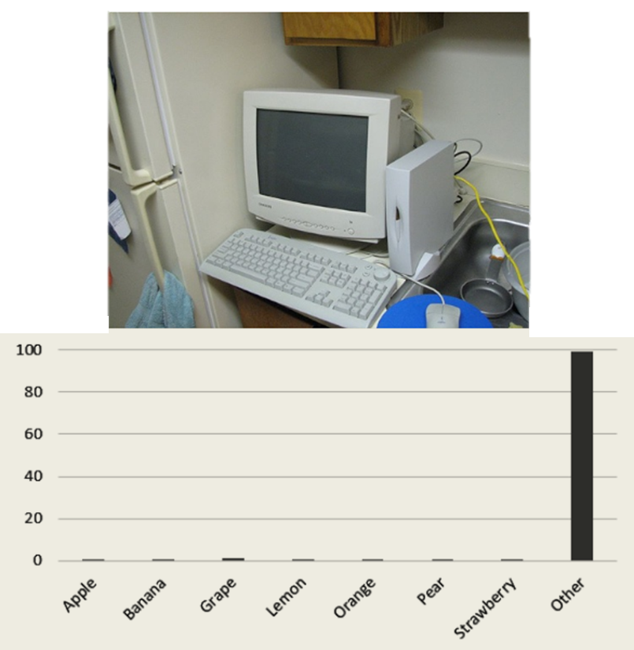
Non-Fruit Classification
Notes:
We added random images to the Other class, and retrained our network, achieving good results

Slide 11
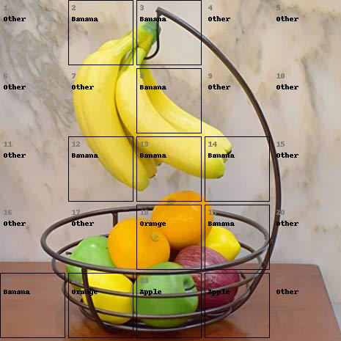
Results
Notes:
Results are decente but fruits rarely fit nice into boxes

Slide 12
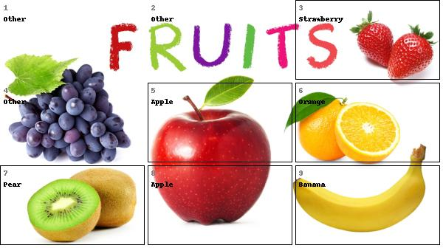

Slide 13
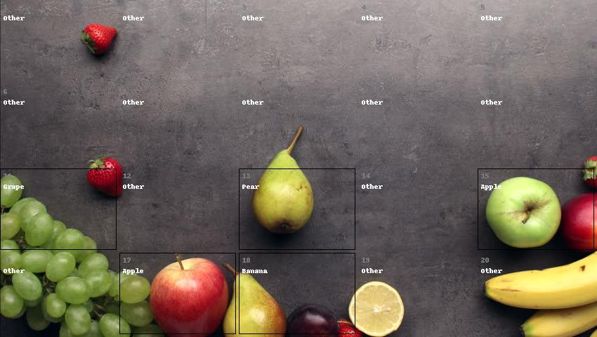
Notes:
Not perfect, slow to run algorithm
Bounding boxes never perfect

Slide 14
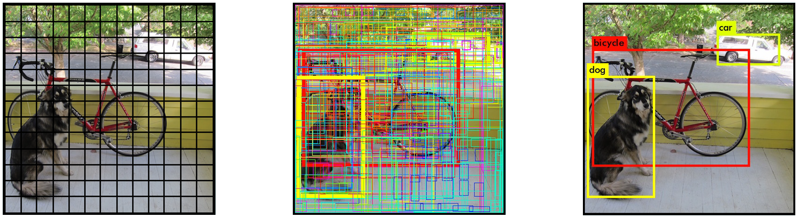
2nd Approach YOLOv2 with COCO Library
Notes:
We decided to compare our results with YOLO, a state-of-the-art, real-time object detection algorithm
We used the Microsoft COCO library which has over 2 million labeled object classes and a model trained with it
We selected only the three labels of fruit that it included: oranges, apples, and bananas

Slide 15
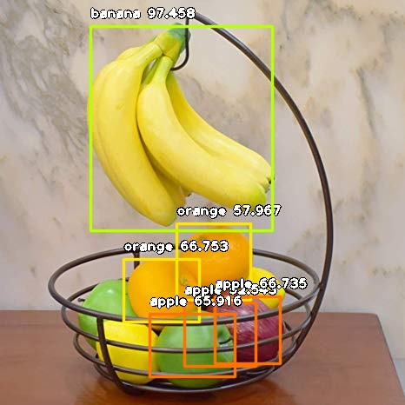
Results

Slide 16
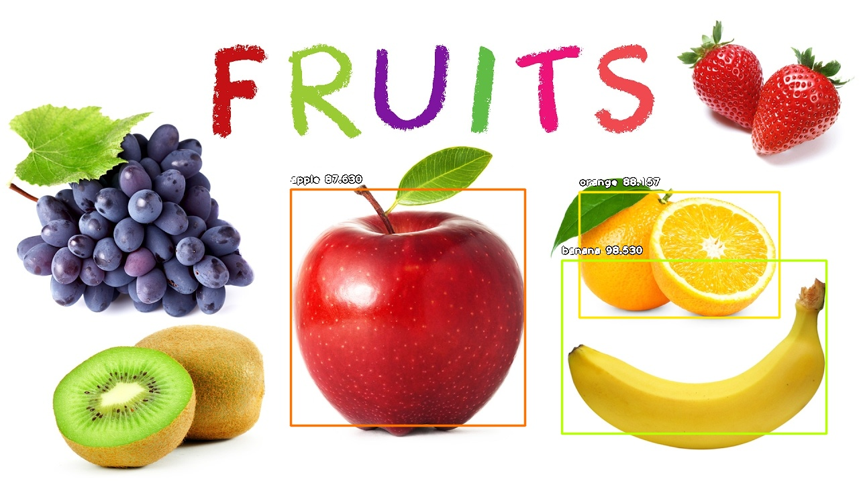

Slide 17
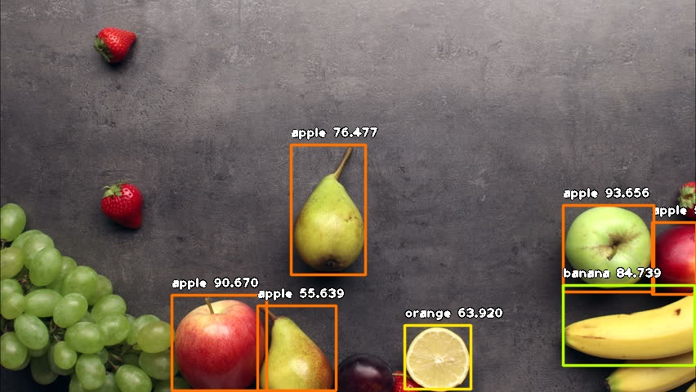
Notes:
Good bounding boxes
Limited to Apple, Banana and Orange

Slide 18
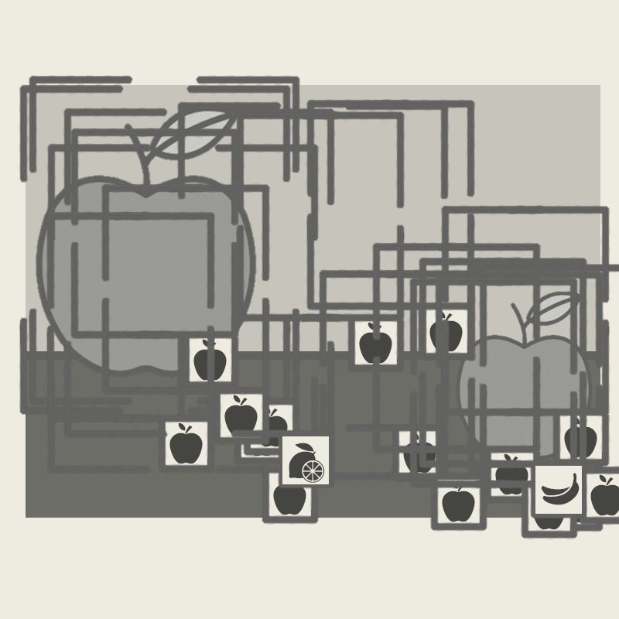
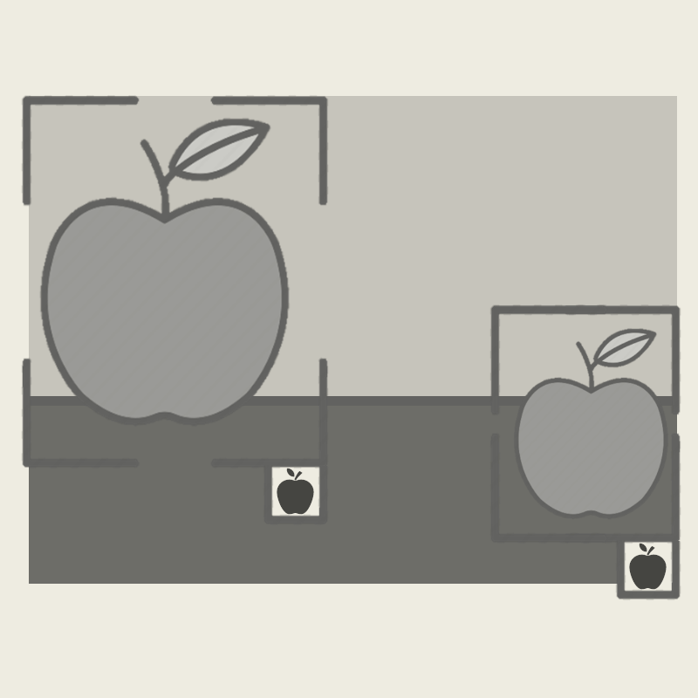
3rd Approach YOLOv2 with Custom Library

Slide 19
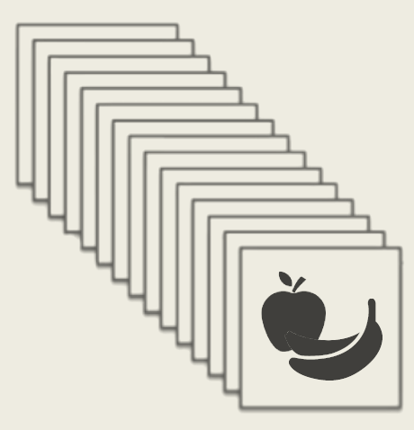
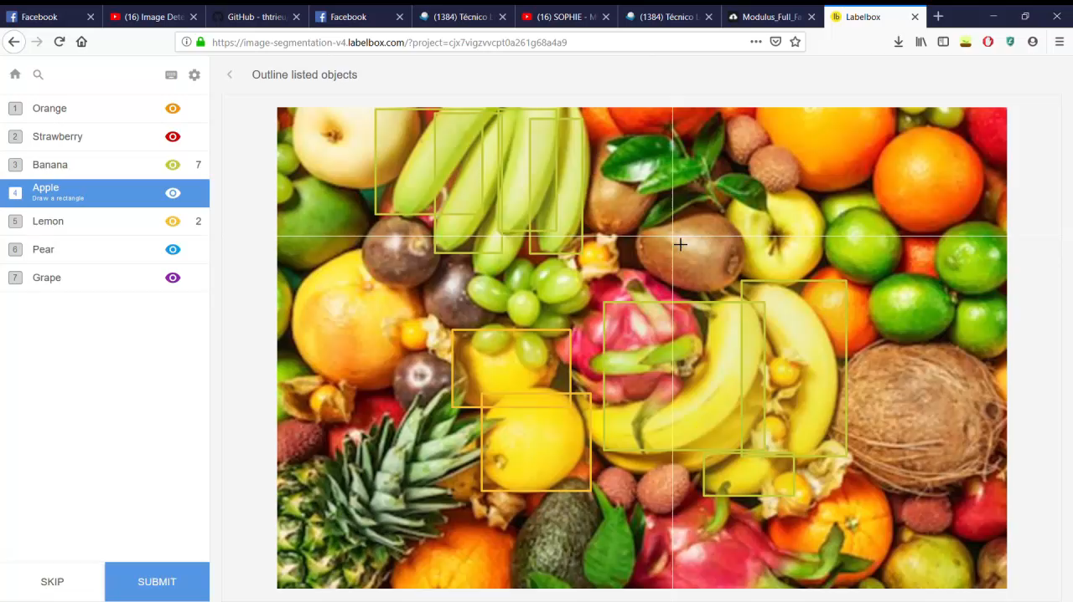
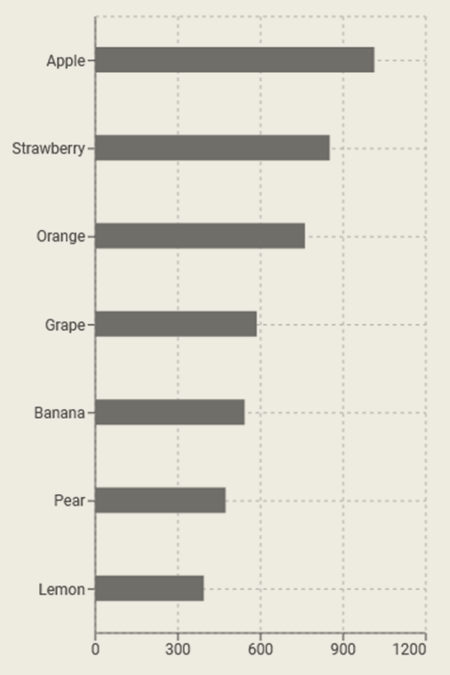
Dataset Augmentation and Adaptation
Notes:
We decided to make the annotations ourselves to get more reliable results.
And then further train a yolo model with our dataset with annotations

Slide 20
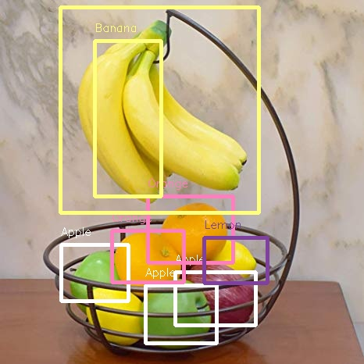
Results

Slide 21
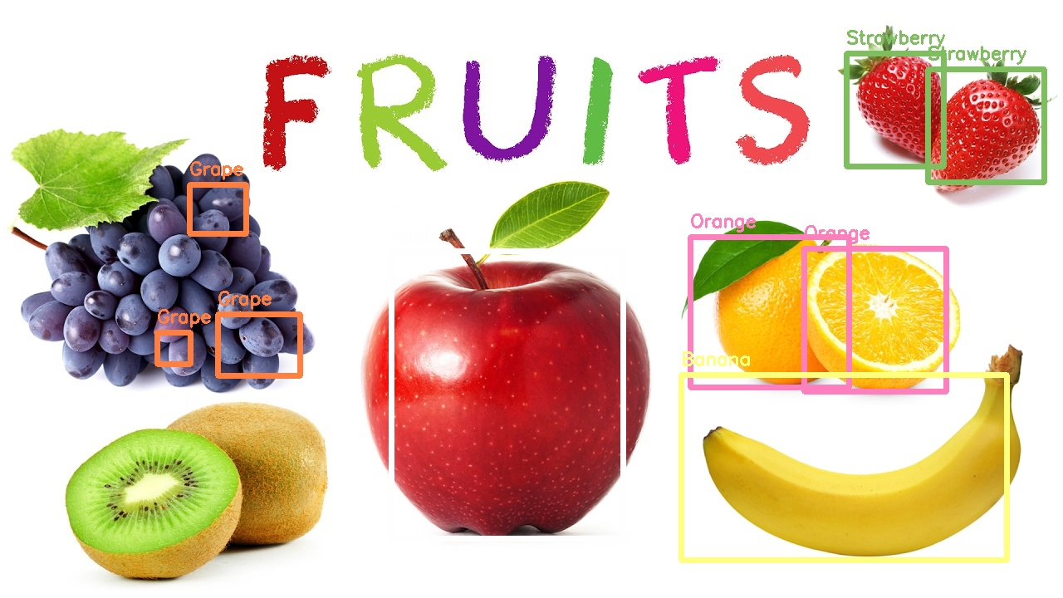

Slide 22
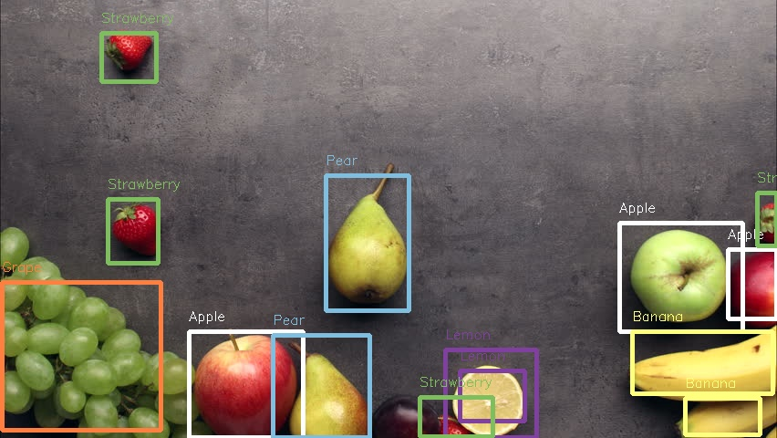

Slide 23
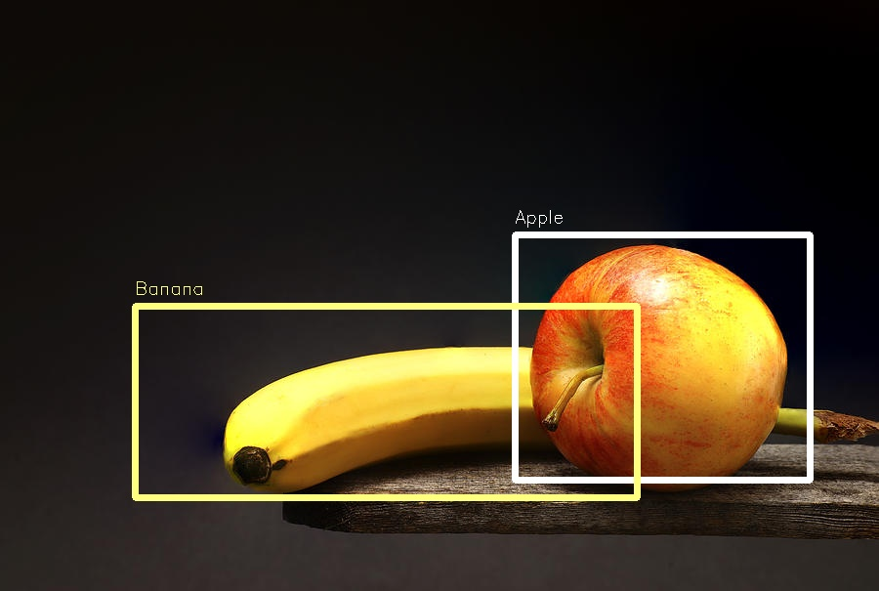
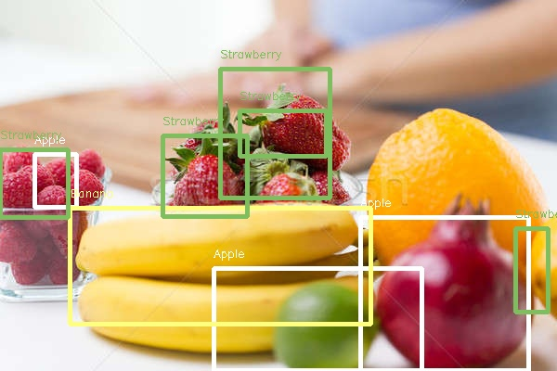
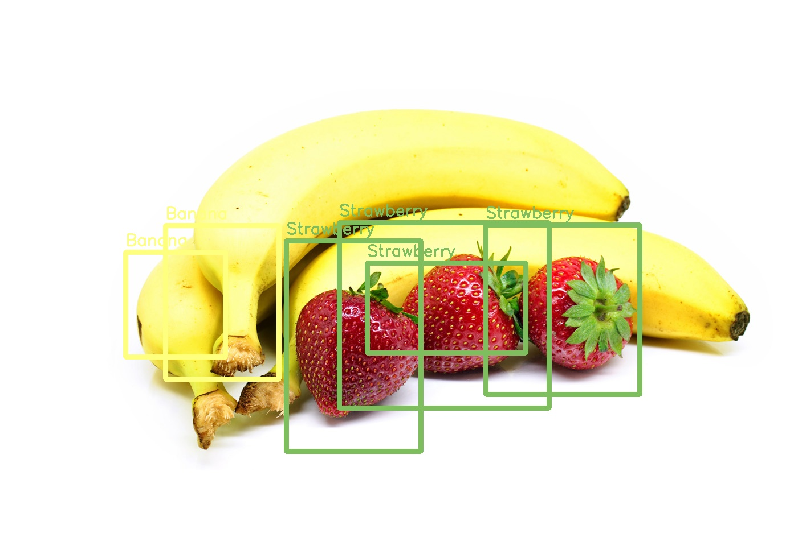
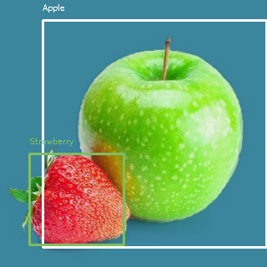
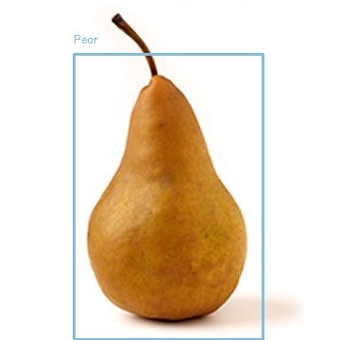
Notes:
Identify some problems (top right mainly) but highlight overall great results

Slide 24
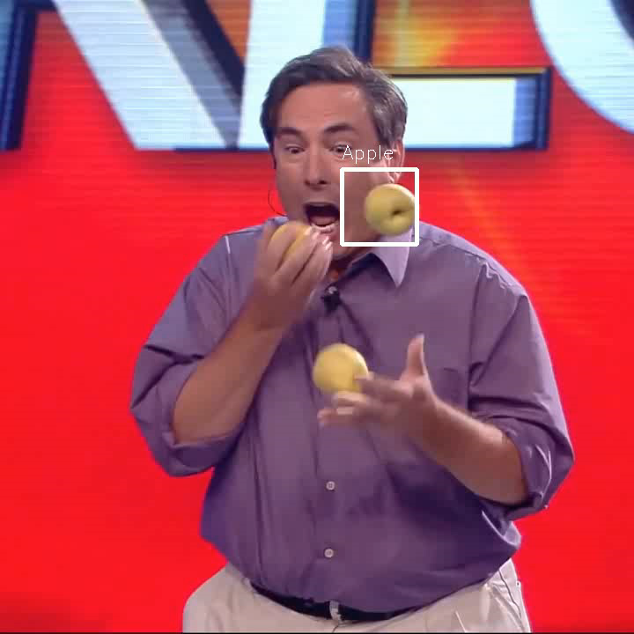
Real-Time Capabilities
Notes:
We can even use it for vídeos!
By using tiny yolo (faster version) we can process vídeos in real time also with good results.
Potential use on smartphones.

Slide 25
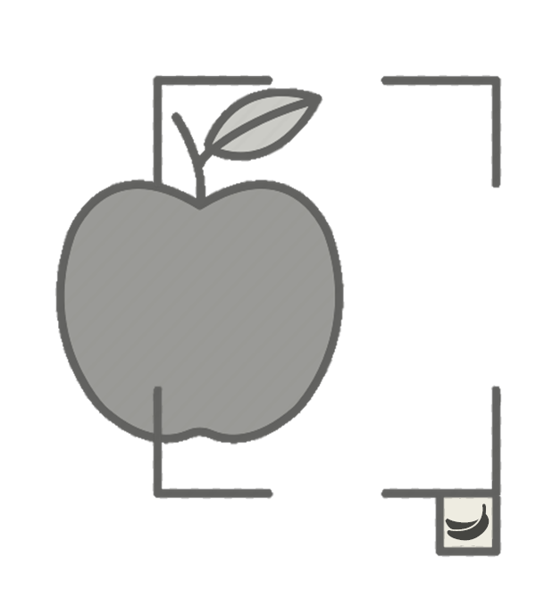
Future Improvements
More fruit classes
More labeled objects
Stronger hardware
Notes:
Add fruits to detect
Extend dataset with more images and labels
Faster, Better, Stronger hardware to agilize training

Slide 26

Thank You!

